Slide 1
Digital Forensics Lecture-5
By- Dr.subhranil Das
Assistant Professor
School of computer Science

Slide 2
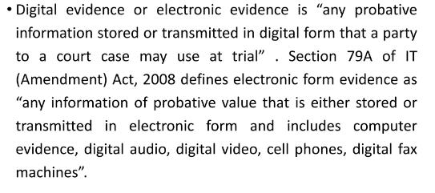
Digital Evidence

Slide 3
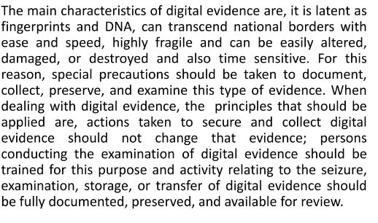
Characteristics of the Digital Evidence

Slide 4
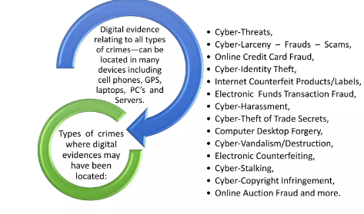
Digital Evidence

Slide 5
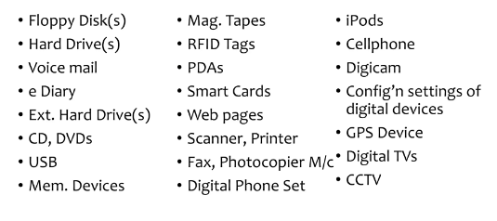
Sources of Digital Evidence

Slide 6
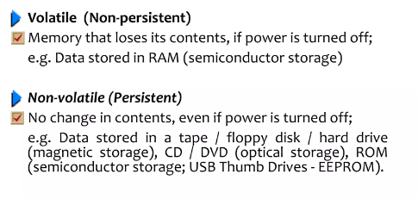
Types of Digital Evidences

Slide 7
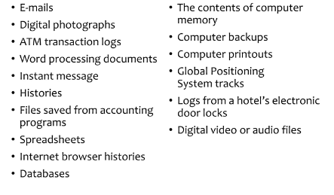
Nowadays Digital Evidences

Slide 8
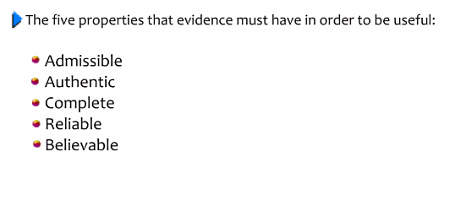
Rules of Evidences

Slide 9
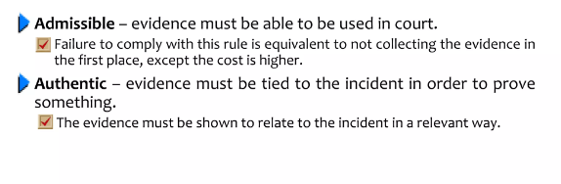
Rules of Evidences

Slide 10
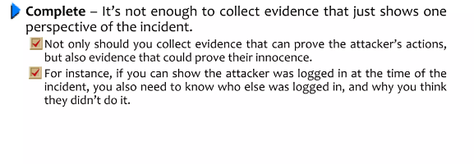
Rules of Evidences

Slide 11
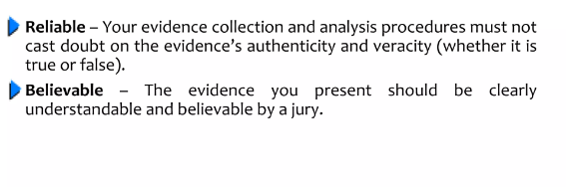
Rules of Evidences

Slide 12
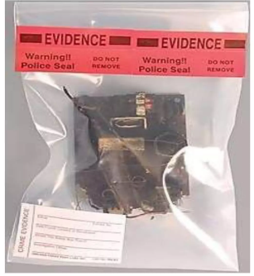
Digital Evidences

Slide 13
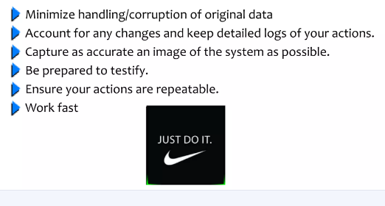
Precautions for taking digital evidences

Slide 14
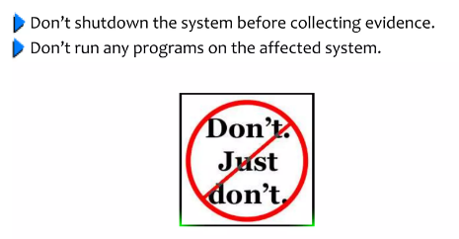
Precautions for taking digital evidences

Slide 15
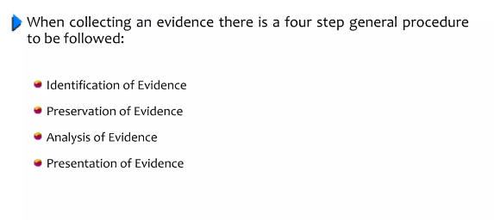
General Procedure

Slide 16
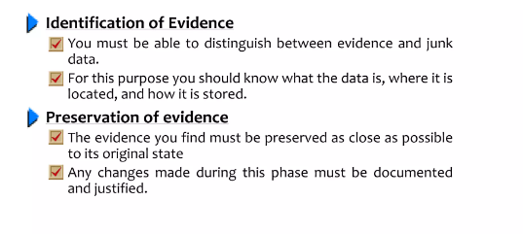
Identification and Preservation

Slide 17
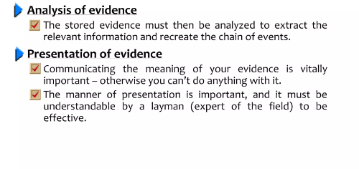
Analysis and Preservation

Slide 18
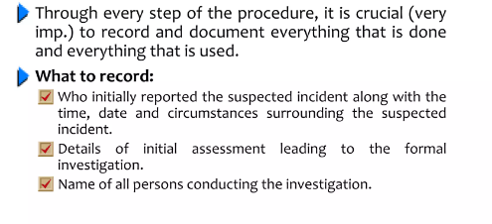
Record

Slide 19
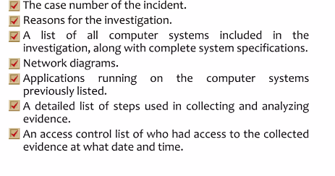
Record

Slide 20
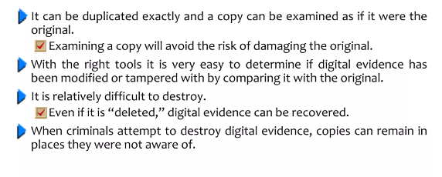
Digital vs Physical Evidences

Slide 21
Case 2 (California 2003)
William Grace and 22-year-old Brandon Wilson were sentenced to 9 years in jail after pleading guilty to breaking into court systems in Riverside, California, to alter records.
Wilson altered court records relating to previous charges filed against him (illegal drugs, weapons, and driving under the influence of alcohol) to indicate that the charges had been dismissed.
Wilson also altered court documents relating to several friends and family members.

Slide 22
Case 2 (California 2003)
The network intrusion began when Grace obtained a system password while working as an outside consultant to a local police department.
By the time they were apprehended, they had gained unauthorized access to thousands of computers and had the ability to recall warrants, change court records, dismiss cases, and read e-mail of county employees in most departments, including the Board of Supervisors, Sheriff, and Superior Court judges.
Investigators estimate that they seized and examined a total of 400 Gbytes of digital evidence (Sullivan, 2003).

